Slide 1
Learning Activity 2.7.2
Image 1
UN Core Pre-Deployment Training Materials 2017

Slide 2
Learning Activity 2.7.2
Image 2
UN Core Pre-Deployment Training Materials 2017

Slide 3
Learning Activity 2.7.2
Image 3
UN Core Pre-Deployment Training Materials 2017

Slide 4
Learning Activity 2.7.2
Image 4
UN Core Pre-Deployment Training Materials 2017

Slide 5
Learning Activity 2.7.2
Image 5
UN Core Pre-Deployment Training Materials 2017

Slide 6
Learning Activity 2.7.2
Image 6
UN Core Pre-Deployment Training Materials 2017

Slide 7
Learning Activity 2.7.2
Image 7
UN Core Pre-Deployment Training Materials 2017

Slide 8
Learning Activity 2.7.2
Image 8
UN Core Pre-Deployment Training Materials 2017

Slide 9
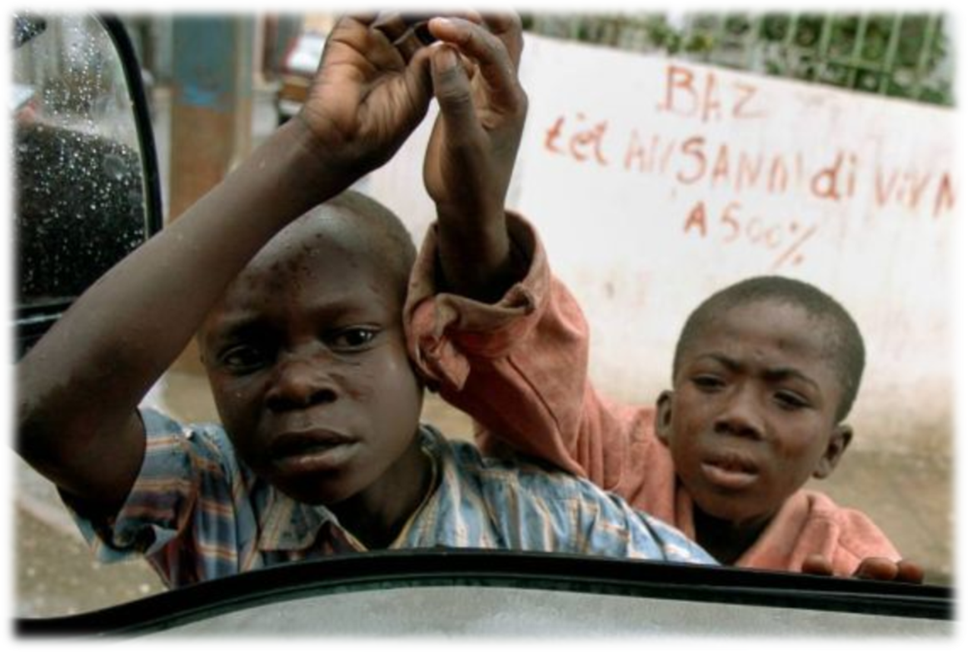
Learning Activity 2.7.4
Scenario 1
You are newly deployed to a UN peacekeeping mission. As you are waiting at a traffic intersection, two little boys come and offer to clean your car for a small amount of money.
UN Core Pre-Deployment Training Materials 2017

Slide 10
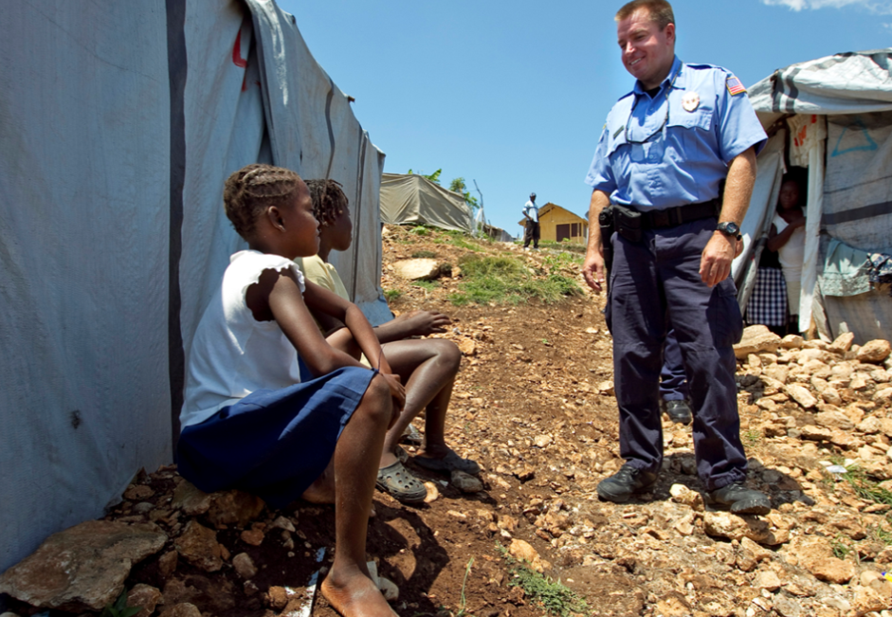
Learning Activity 2.7.4
Scenario 2
As you are walking around the mission compound, you notice that a UN Police officer is talking to two teenage girls after giving them boxes of food. After a while, you see them leaving together.
UN Core Pre-Deployment Training Materials 2017

Slide 11
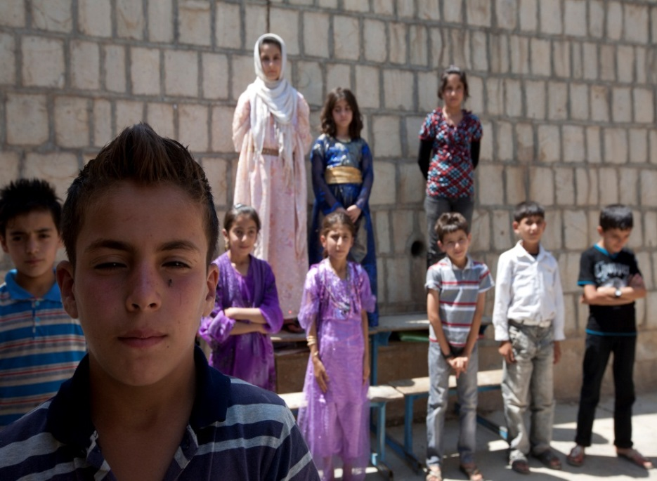
Learning Activity 2.7.4
Scenario 3
You are playing a soccer match with some other peacekeeping personnel during your off-duty hours. Some children are watching your game, and ask to join you.
UN Core Pre-Deployment Training Materials 2017

